Slide 1






s.erzv
serzv.my.id
Data Series 17.0
Artificial Intelligence Machine Learning
With Final Project Salary Prediction
Presented By : Sarah Fajriah Rahmah
February 2025

Slide 2


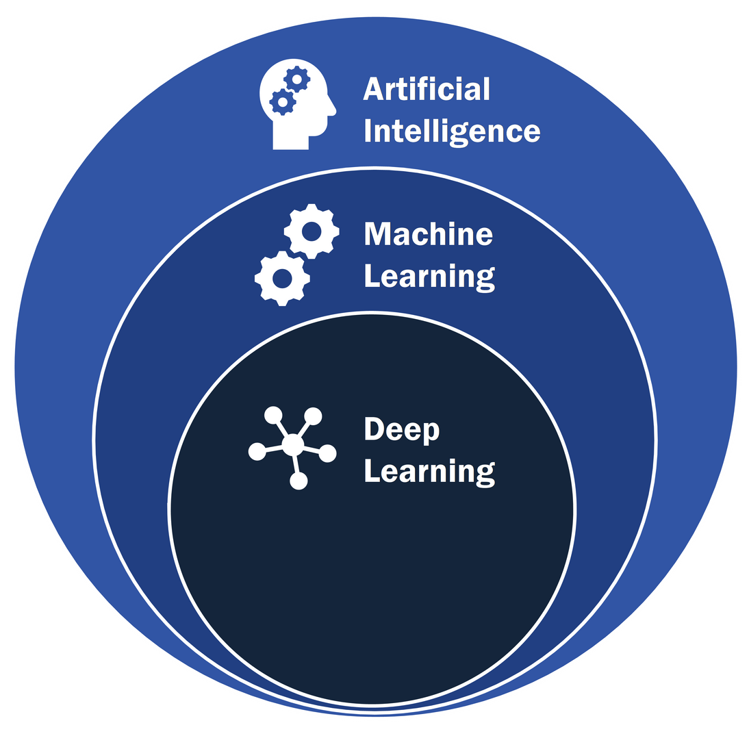

s.erzv
serzv.my.id
What is AI/ML?
Artificial Intelligence (AI) is a technology that enables computers to perform tasks that normally require human intelligence. AI can learn, reason, plan, and solve problems.
Machine learning (ML) is a branch of AI focused on enabling computers and machines to imitate the way humans learn, perform tasks autonomously, and improve their performance and accuracy through
experience and exposure to more data.
Image Source

Slide 3



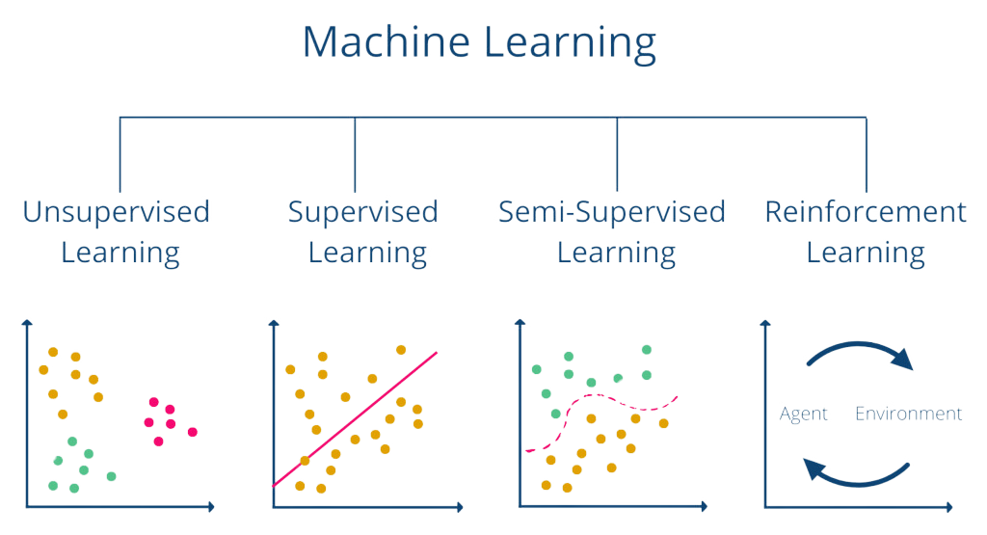
s.erzv
serzv.my.id
Category of
Machine Learning
Supervised
Unsupervised
Reinforcement

Slide 4

s.erzv
serzv.my.id
Machine Learning Process
Data
Preprocessing
Training
Validation
Checking whether there
are missing values ​​in the
data to be analyzed
The process of teaching an ML algorithm to recognize patterns
and predict outcomes
The process where a trained model is evaluated with a
testing data set
Testing
The process where the
performance of a fully trained
model is evaluated on a testing set
Overfit
Goodfit
Underfit
Model

Slide 5
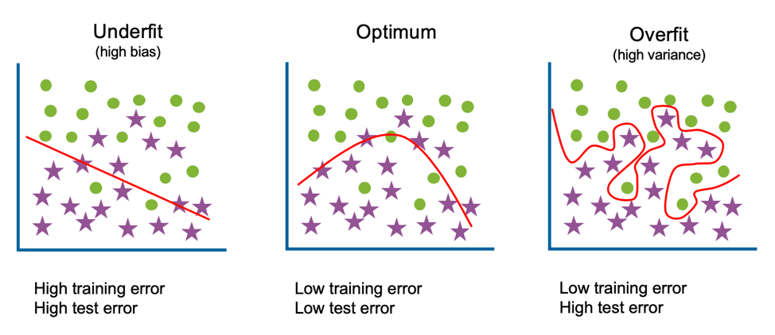

s.erzv
serzv.my.id
What is Overfitting/
Underfitting?
Overfitting is a machine learning issue that occurs when a model is too closely trained to a training set, making it unable to accurately predict new data.
Underfitting is a machine learning issue that occurs when a model is too simple to capture the patterns in training data. This results in poor performance on both training and test data.
Image Source

Slide 6




s.erzv
serzv.my.id
Final Project
Supervised Learning
Salary Prediction
s.id/salaryPredictionML

Slide 7


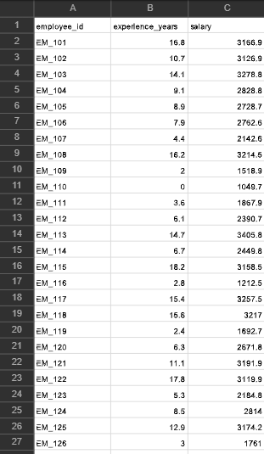

s.erzv
serzv.my.id
Supervised Learning
Salary Prediction
This project develops a supervised machine learning model to predict salaries based on years of work experience using the salary_data.csv dataset, which contains 100 records and 3 columns (years of experience, salary, and an ID). It compares the performance of linear regression, decision tree, and random forest algorithms to identify the most effective approach for salary prediction.

Slide 8

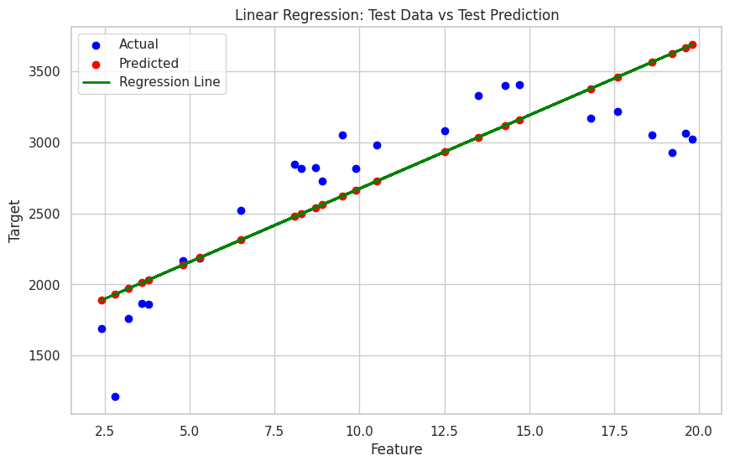
s.erzv
serzv.my.id
Linear Regression
The Linear Regression model is moderately effective, with R² scores of 0.77 (train) and 0.63 (test), but shows signs of underfitting as it struggles to capture data complexity, especially with outliers.
Mean Squared Error:
Train: 107699.85
Test : 128111.12
Gap : 20411.27
R^2 Score:
Train: 0.77
Test : 0.63

Slide 9
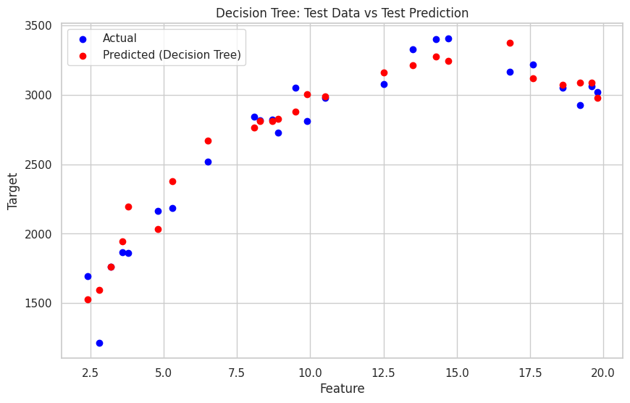
s.erzv
serzv.my.id
Decission Tree
The Decision Tree model shows excellent performance on the training data with an R² score of 1.00, and a strong performance on the test data with an R² score of 0.93. However, the significant gap in Mean Squared Error (MSE) between training (88.12) and test (23,627.99) suggests that the model may be overfitting the training data.
Mean Squared Error: Train: 88.12
Test : 23627.99
Gap : 23539.87
R^2 Score:
Train: 1.00
Test : 0.93

Slide 10
s.erzv
serzv.my.id
Random Forest
The Random Forest model demonstrates strong performance with an R² score of 0.99 on the training data and 0.94 on the test data, indicating excellent predictive capability and minimal overfitting. While the Mean Squared Error (MSE) is higher on the test data (21,744.73) compared to the training data (3,737.44), the gap (18,007.29) suggests the model generalizes well to unseen data. This result indicates the Random Forest model effectively captures patterns in the data while maintaining robustness.
Mean Squared Error: Train: 3737.44
Test : 21744.73
Gap : 18007.29
R^2 Score:
Train: 0.99
Test : 0.94

Slide 11
s.erzv
serzv.my.id
Comparison
Linear Regression
Decision Tree
Random Forest
Mean Squared Error: Train: 107699.85
Test : 128111.12
Gap : 20411.27
R^2 Score:
Train: 0.77
Test : 0.63
Mean Squared Error: Train: 88.12
Test : 23627.99
Gap : 23539.87
R^2 Score:
Train: 1.00
Test : 0.93
Mean Squared Error: Train: 3737.44
Test : 21744.73
Gap : 18007.29
R^2 Score:
Train: 0.99
Test : 0.94

Slide 12

s.erzv
serzv.my.id
Conclusion
The Random Forest model demonstrates strong performance with an R² score of 0.99 on the training data and 0.94 on the test data, indicating excellent predictive capability and minimal overfitting. While the Mean Squared Error (MSE) is higher on the test data (21,744.73) compared to the training data (3,737.44), the gap (18,007.29) suggests the model generalizes well to unseen data. This result indicates the Random Forest model effectively captures patterns in the data while maintaining robustness.

Slide 13


s.erzv
serzv.my.id
Thank You So Much
Presented By : Sarah Fajriah Rahmah
February 2025

